Slide 1
Extended Learning Time:
A Model for School Turnaround
Carin Reeve-Larham, Principal
Dr. Weeks Elementary School
Notes:
Carin will introduce the presentation and the team
Share brief leadership story - how I came to Dr. Weeks

Slide 2
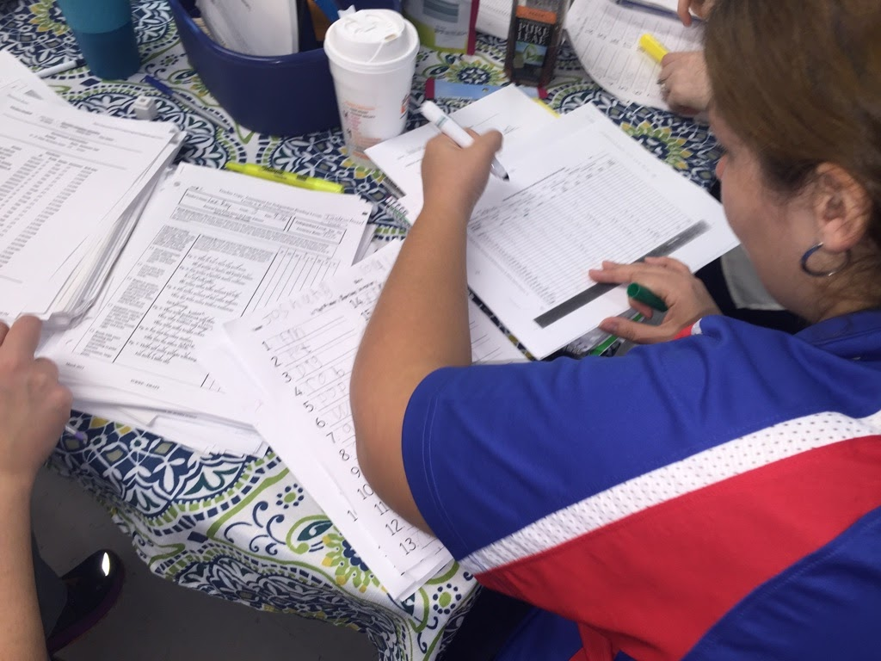
Why should we look at time differently when thinking about school turnaround? According to the National Center for Time and Learning, extended learning time, or expanded learning time, provides students in struggling schools with the time that they need to “catch up” and achieve.
Extended Learning Time:
A Promising Practice
Notes:
Carin - it’s not just about extending the school day - extended learning time must be combined with a clear vision, high quality instructional practices, and a purposeful investment into changing teacher practice.
A longer day without effective instruction and higher levels of engagement will not produce results.
Duality of investment – investing in teachers while also investing in students

Slide 3
Children living in poverty face a growing educational and opportunity gap:
By 4th grade, children living in poverty are 31 percentage points below their more affluent peers in reading proficiency.*
Families in the top income quartile spend 9 times more on educational opportunities outside the school day than families in the bottom income quartile.*
http://users.nber.org/~dynarski/Bailey_Dynarski.pdf
Why Extended Learning Time?
Notes:
Carin share the issue of the gaps in learning for students in poverty
In a recent Hechinger report, they stated that by the time children of poverty reach 6th grade, they have spent an average of 6,000 fewer hours than children from wealthier households (http://hechingerreport.org/more-quality-time-schools-best-weapon-in-the-battle-against-poverty/)
Address the issues of classroom interruptions, lack of experiences like museums/zoos, fewer vocabulary – schools are challenged to fill this learning gap within a 6.5 hour school day

Slide 4
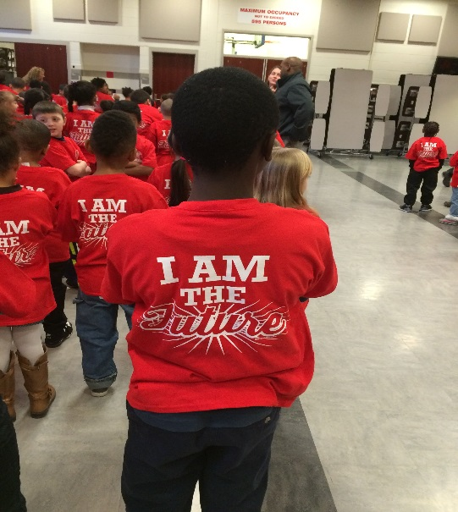
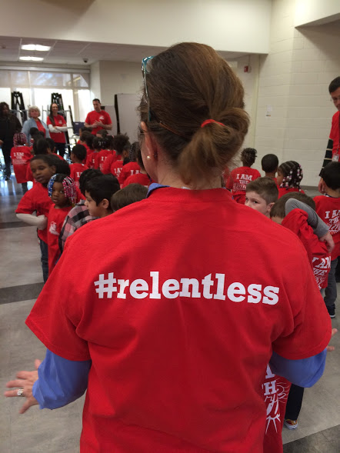
Over 800 students in grades P-5
Turnaround school since 2014
Partnership with Syracuse University to provide daily enrichment instruction
Struggling school in Receivership since 2015
25% of our student body receiving ENL supports
Culture and Climate focus
#RELENTLESS
Dr. Weeks Elementary School
Notes:
Carin - Background of Dr. Weeks and why I am passionate about the success of Dr. Weeks and the northside community
I knew what I was walking in to 3 years ago and I wanted to know how we could create a school where I would be proud to send my own kids. We have continued to use that as a part of our living vision – “Every child. Every day. College and career ready.”

Slide 5
Reduction in suspension and discipline referrals
Reduction in chronic absenteeism
Increase in coaching cycles that include practice
Increase in effective teacher practice and implementing strategies around instructional priorities
Increase in teacher retention
Increase in participation in parent/community events
Increase in NYS Assessment data
Increase in Writing benchmark assessment data
Extended Learning Time Early Wins: #results
Notes:
Carin will share some of the early wins that we have seen since shifting into an extended learning time

Slide 6
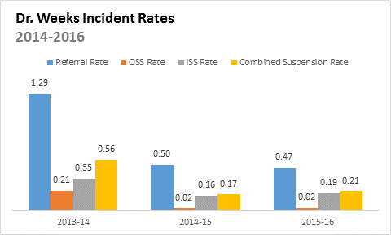
#Results
Notes:
Discipline data shows that since we have lengthened our day, we have actually decreased in our referral and suspension rates – our model of collaborative team planning allows time during the school day for targeted professional development, coaching, peer observations (instructional rounds), and Kid Talk Protocols which align to our restorative practices and vision.
Point out the work done with restorative practices, the use of CTP to train and practice with teachers

Slide 7
#Results
Notes:
Our model of extended learning time allows us to have time in our schedule for morning meeting and closing circle and allows for structures like restorative circles to be embedded into the instructional day, which has resulted in a significant reduction in overall referrals and suspensions.
Academic data is increasing while suspension data is decreasing. Point out the academic data included in the packets – NYS ELA (2%-7%) NYS Math (6%-10%)

Slide 8
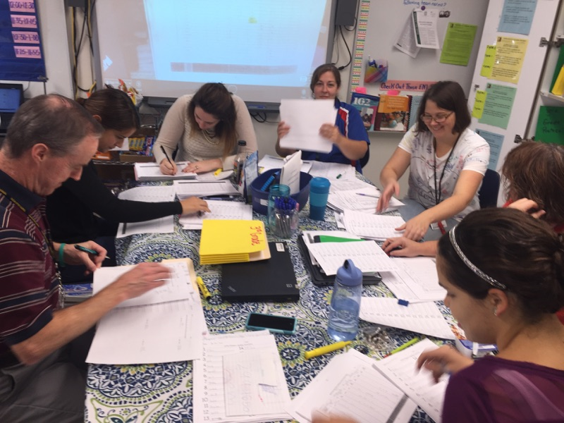
Extended Learning Time at Dr. Weeks
“Investing in Teachers and Students”
Collaborative Team Planning
Embedded Enrichment
Targeted Intervention
Summer Academy
Results
Extended Learning Time at
Dr. Weeks
Notes:
The components of Extended Learning Time – different models exist so what makes ours successful? Our model of Extended Learning Time centers around the idea of investing in both students and teachers and making every moment count through effective instructional practices and increased engagement.
There are many models for extended learning time – our model focuses on the duality of investment in children and teachers through embedded enrichment programming and collaborative team planning.

Slide 9
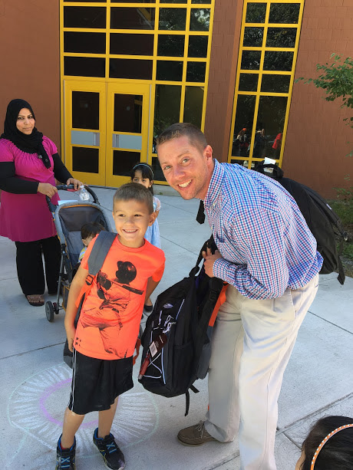
Actual school day was adjusted to 8:30 a.m. - 4:10 p.m. for students.
Syracuse University became the CBO providing embedded enrichment programming during the school day to all of the Dr. Weeks students.
The addition of 300 hours of extended learning time resulted in students receiving daily enrichment, an extended writing block, and a daily intervention block.
Expanding the school day
Notes:
Carin will explain the structural changes that support our extended learning time. Change is challenging. When I took over Dr. Weeks, there was no culture of learning, it was unsafe, and the expectations for our children had been very low for a very long time. All that being said, people don’t like change. Families, children, and the community needed support in accepting the changes. Bringing on a partner was challenging - it took a considerable amount of work on everyone’s part to make the implementation successful.

Slide 10
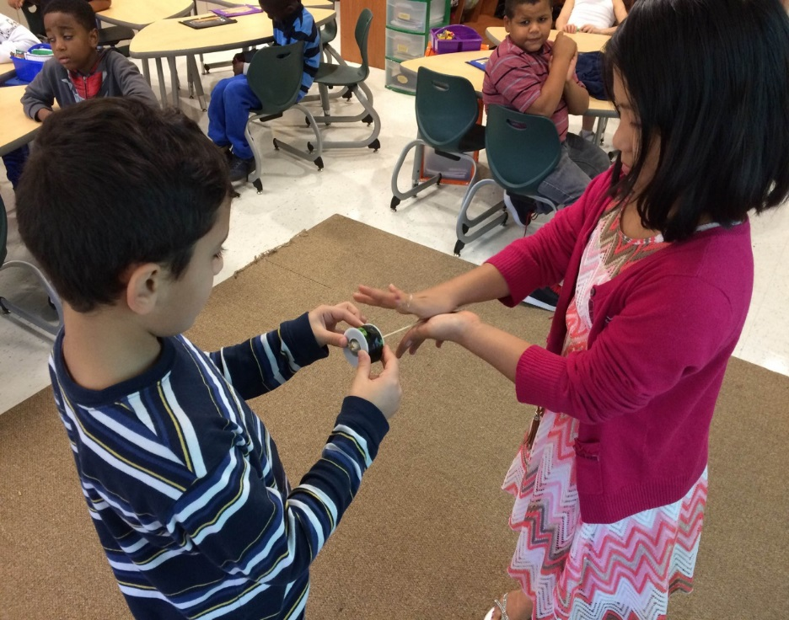
While students are…
Working with enrichment teachers on a variety of STEAM related topics
Engaged in design-thinking and developing ideas
Developing creative problem-solving skills
Collaborating with their peers
Exploring and investigating in hands-on, project-based learning
Experiencing learning outside the classroom
Extended Learning Time: #gamechanger
Notes:
Carin will explain the purpose behind what students are doing and what teachers are doing during Enrichment/Collaborative Team Planning

Slide 11
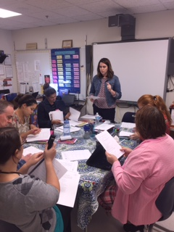
Teachers are…
Unpacking instructional standards and instructional planning
Analyzing student data and tracking progress against targets and goals
Collaborating to improve student achievement and developing intervention plans
Participating in professional development aligned to the goals of the school
Observing instruction, giving feedback, practicing effective strategies
Extended Learning Time:
A Promising Practice

Slide 12
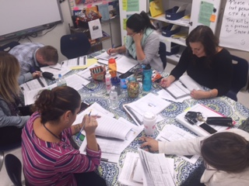
What happens during CTP?
Professional Development
Kid Talk Protocol
Data Analysis and Instructional Planning
Practice
Collaborative Team Planning
Notes:
Lisa will transition into what teachers do during Collaborative Team Planning
Lisa will go deeper into what teachers and grade level teams are involved in during CTP and will give examples
What are teachers engaged in during the Collaborative Team Planning time?

Slide 13

Prior to
Extended Learning Time
Notes:
Prior to ELT CTP – tracy
30 minutes of PD everyday, entire staff, focused on district initiatives, many outside presenters, social workers, coaches, and administrators
Purpose was to deliver information, felt like staff meeting, (sit and get) one size fits all
Teachers would miss days due to conferences/pd outside the building, once teachers returned from workshops there was not a lot of transfer into the classroom due to lack of support or the PD not aligning to the vision of the school
Many
(CTP memo)
40 minutes planning time daily
Phone calls, check mailboxes, paperwork, “lesson plans”
Total of 70 min daily of “housekeeping”

Slide 14
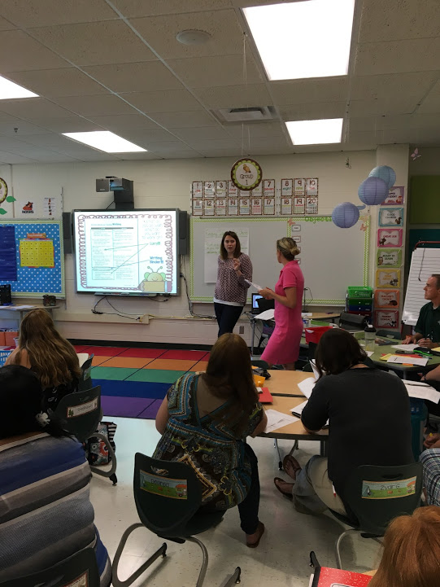
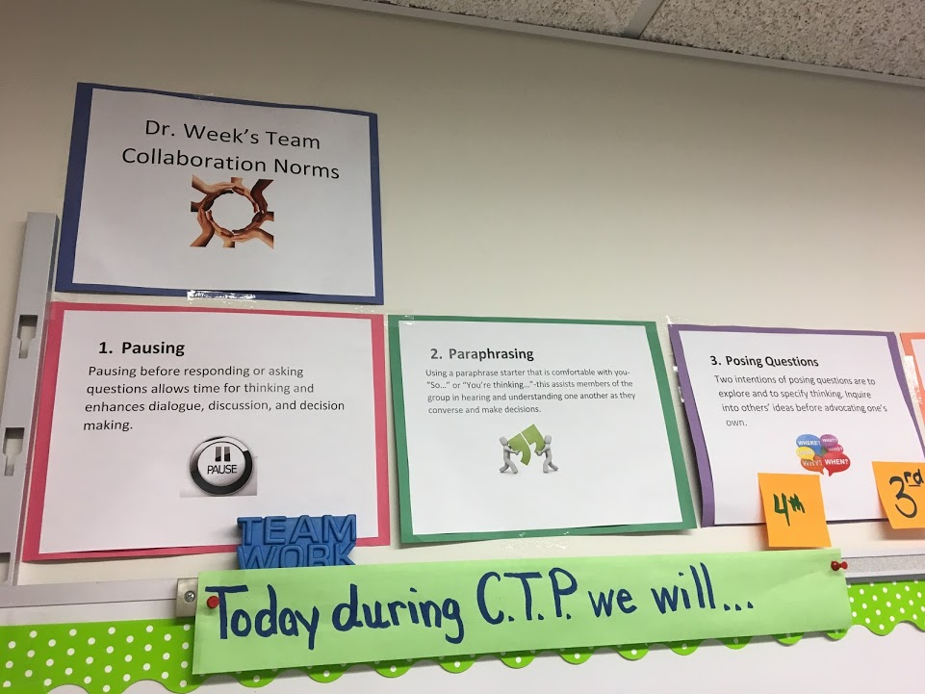
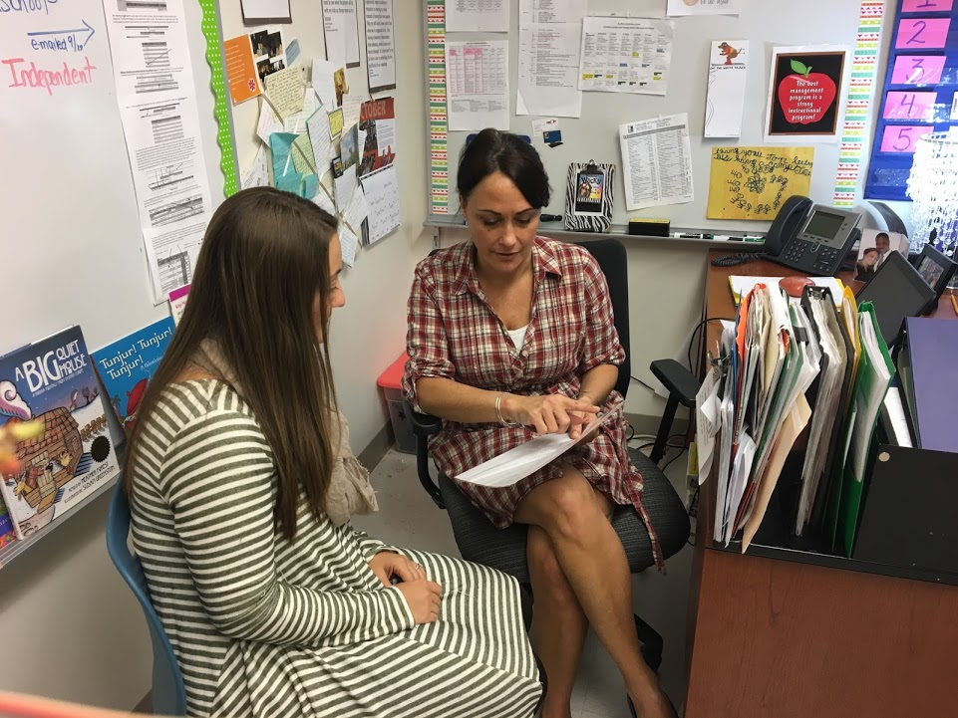
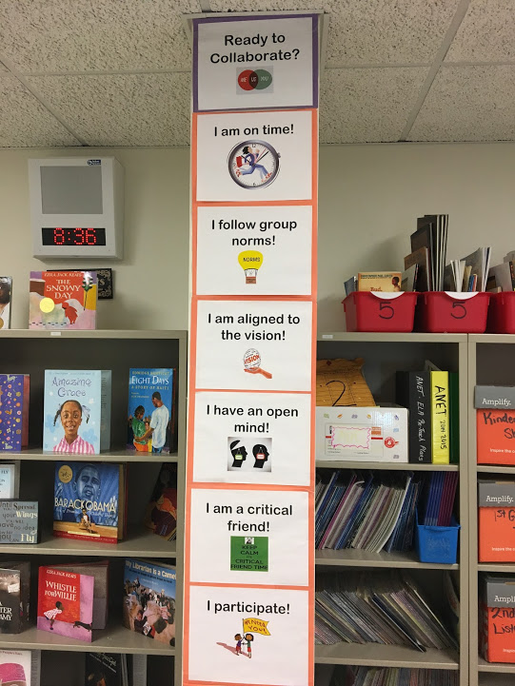
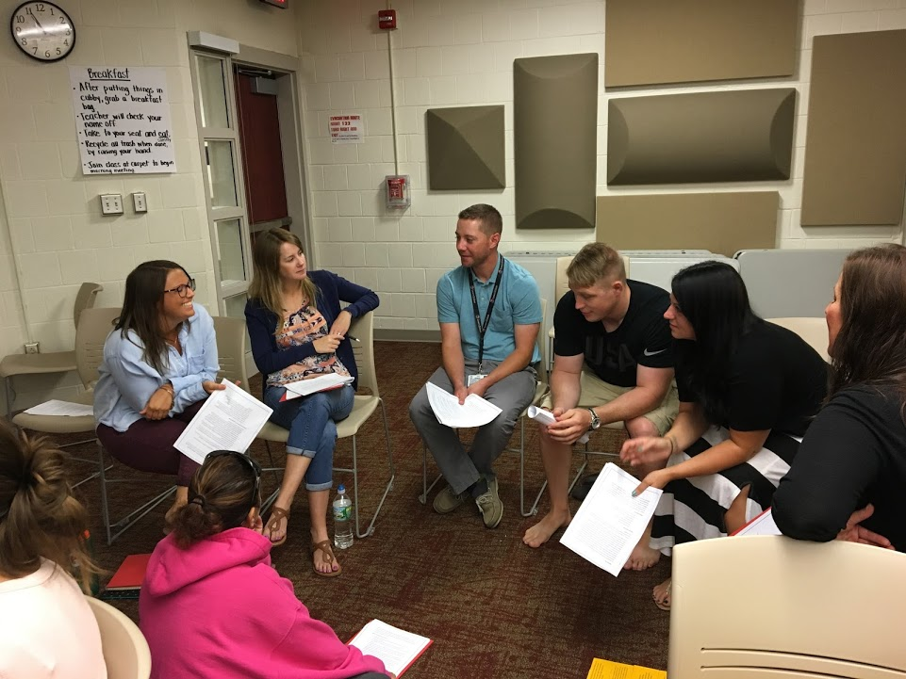
Extended Learning Time:
#Collaboration
Notes:
ELT
CTP is…
50 minutes daily
Grade level teams meet (personalized pd) with classroom support (coaching cycles) align with PD- another layer of support
Daily objectives aligned to vision of the school
Norms, protocols, systems and structures
50 minutes + 40 minutes= 90 minutes daily of working towards our common vision
Picture of objectives/weekly message

Slide 15

5,400 minutes (Contractual Time outside the day)
7,200 minutes (Planning)
12,600 minutes - mostly housekeeping
9,000 minutes (Collaborative Team Planning)
7,200 minutes (Planning)
16,200 minutes purposefully aligned to vision
Time Comparison
Notes:
Side by side chart was now minutes
Was
30 min all staff pd 5,400 min.
40 min personal planning 7,200 min.
70 min of “stuff” 12,600 min
Now
50 min CTP 9,000 min.
40 min personal planning 7,200 min.
90 min of doing work that aligns with our vision 16,200 min.

Slide 16
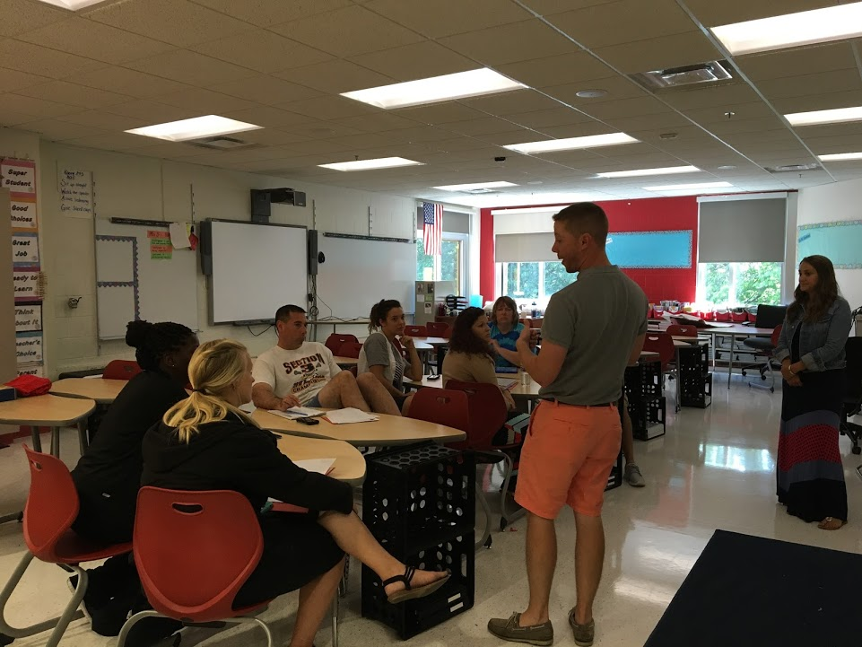

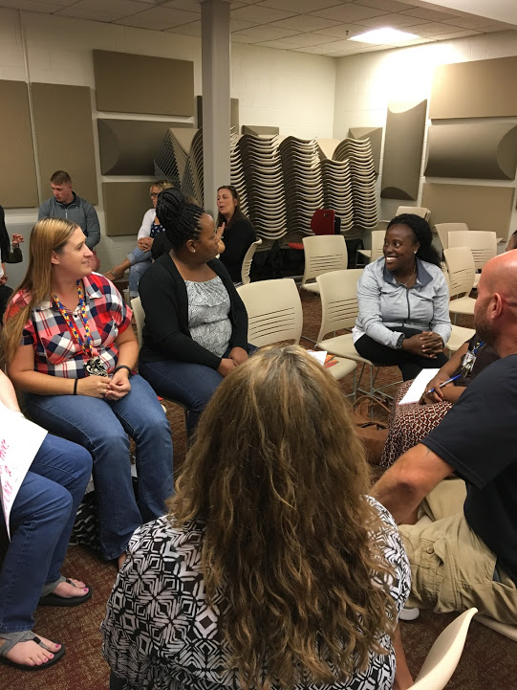
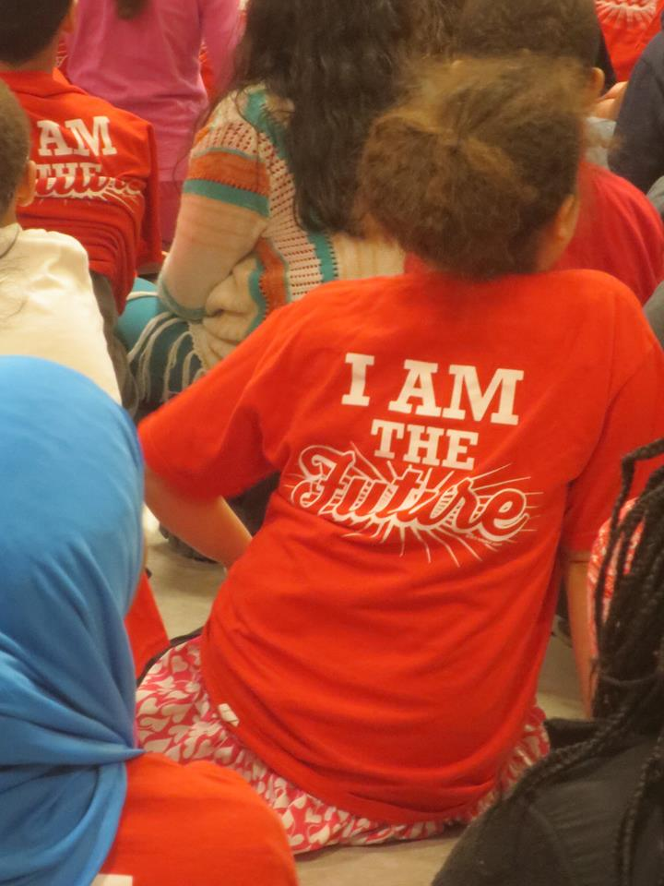
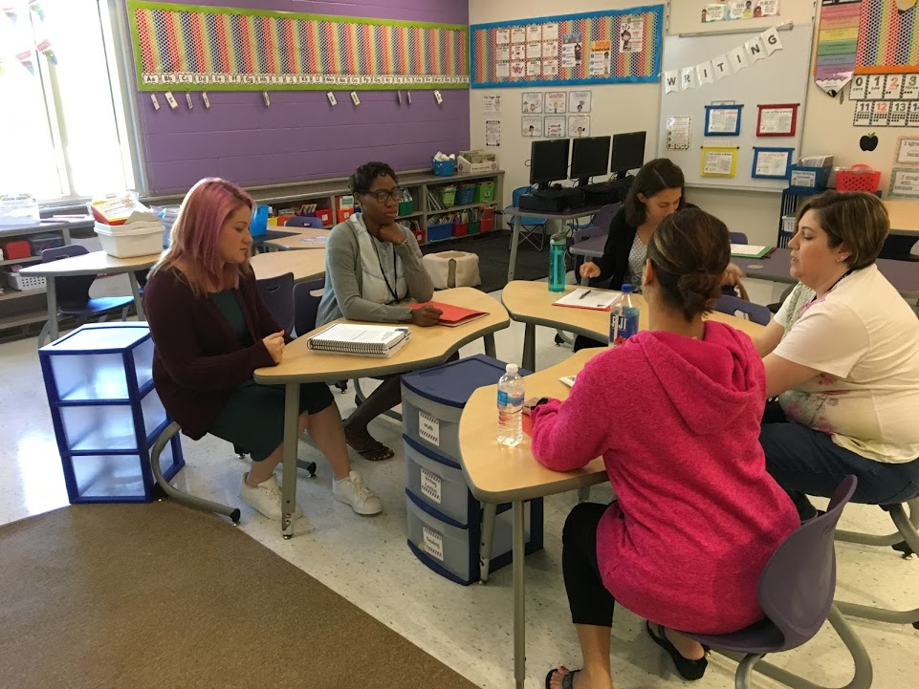
Evidence of Impact
Notes:
how what we are doing now looks better- we are truly doing every part of CTP- collaborative team planning
We ARE collaborating
our CTP is driven by us, for our teachers and our students- “buy in” isn’t a factor because the teachers drive the PD based off their professional needs and their students, it is not an “outside”/isolated learning experience, we are working towards a common vision EVERYTHING that we collaborate about aligns with our school vision, so every team, everyday plays a part of moving our school closer to its vision everyday
We are building teams and leadership, during this time everyday. Through “buy in”, time together, structures and protocols, participants on the team are driving the work. It used to be that an administrator or coach would sit in on all CTP times, to ensure the work is getting done. Since the work is coming from the teams, there is a drive to meet the daily objectives and teams rely on each others strength and trust to get the work done
Planning isn’t about filling page numbers in a plan book. Our planning entails taking turns practicing executing a lesson or new strategies with “on the spot” feedback from peers.

Slide 17
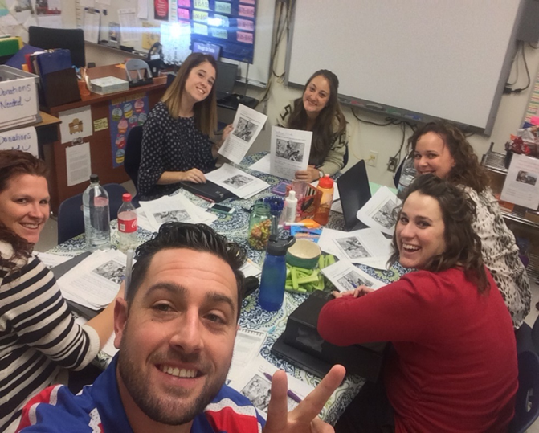
Where the MAGIC happens!
Beliefs
Conditions
Norms
Protocols
Collaborative Team Planning
Notes:
Lisa will talk about how collaborative team planning works: what are the conditions that have to be in place?
In order for this to be effective, our actions have to match our beliefs. The conditions have to be set for teachers to develop their practice - uninterrupted time, teachers are able to focus on their work, meet the same time each day, objectives are set and align to school vision and goals, teachers have norms for collaboration and reflect on their goals, and protocols are in place for examining student work, having kid talk, or instructional planning. They have 50 minutes to work their magic and we want to make it as smooth as possible for them.

Slide 18
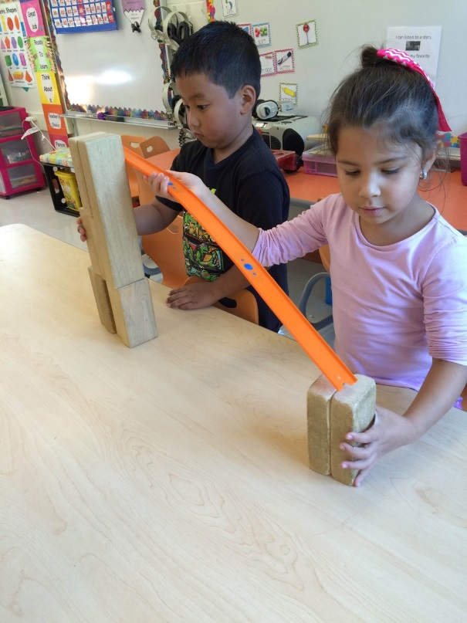
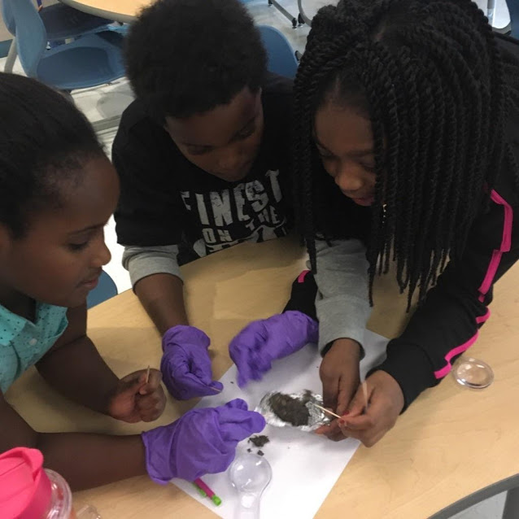
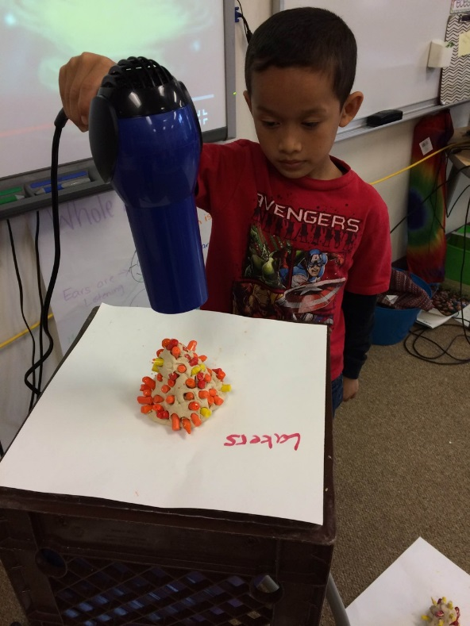
50 minutes per day = 9,000 minutes per school year
Enriching curriculum, not just enriching children
Embedded Enrichment Programming
Notes:
Transition to Anne –
Anne will explain the structure of daily embedded enrichment programming at Dr. Weeks

Slide 19
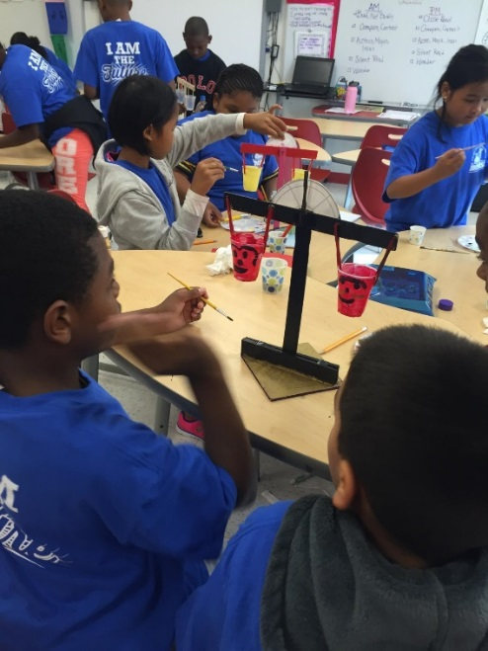
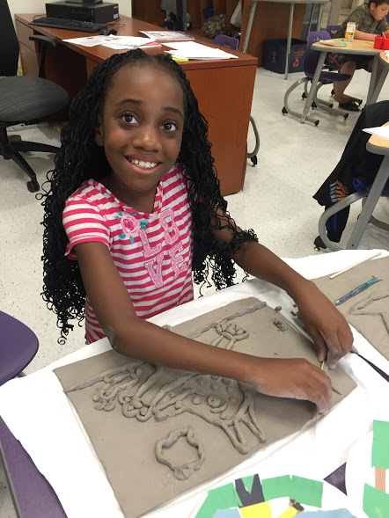
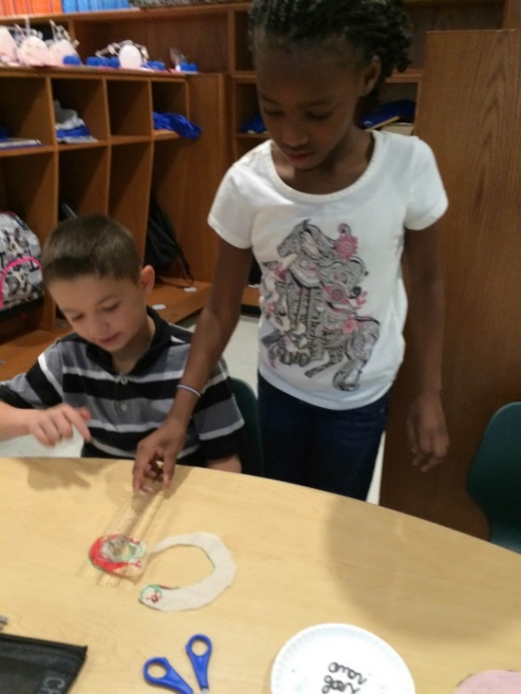
Enriching Curriculum…
How does that happen?
STEAM focus
Alignment to Next Generation Science Standards
Engagement = Hands-on and minds-on
Coordinating experiences and learning
Requires collaboration (not just a stand alone program)
Embedded Enrichment Programming
Notes:
How did our understanding of enrichment curriculum evolve? Anne will highlight the curriculum shifts, the work of the enrichment program

Slide 20
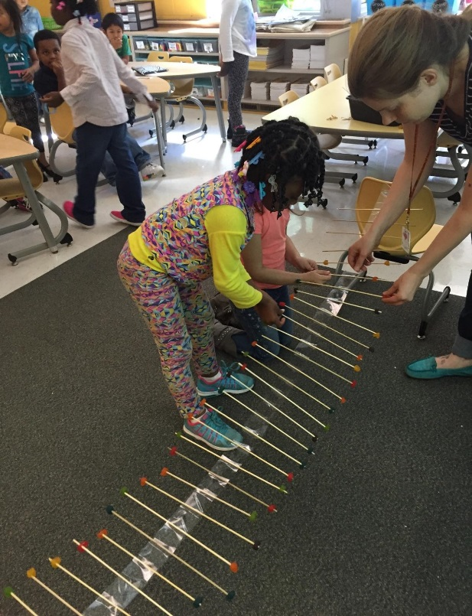
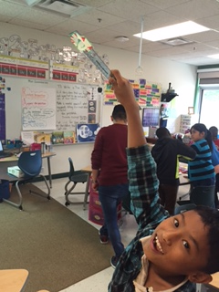
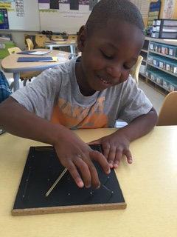
Hands-on, Minds-on
Embedded Enrichment Programming
Notes:
Defining Engagement – Anne will outline how “hands-on, minds-on” looks in enrichment classes; what we have learned about structuring

Slide 21
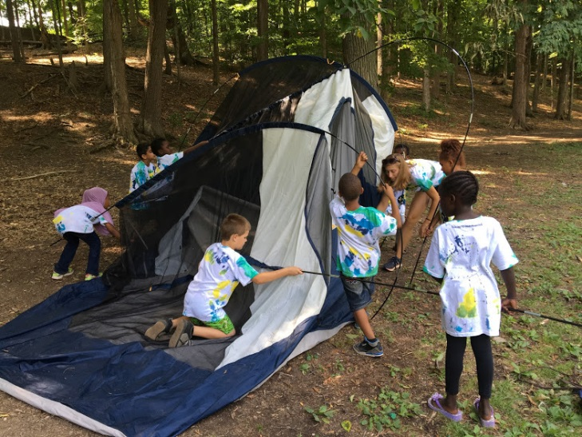



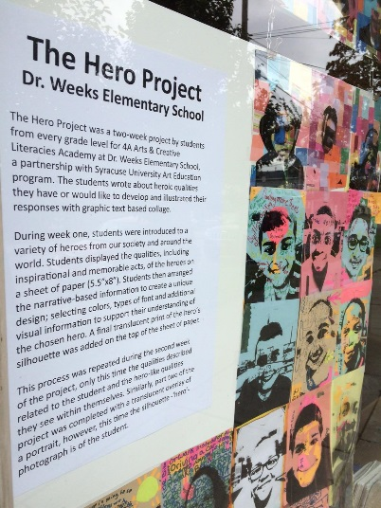
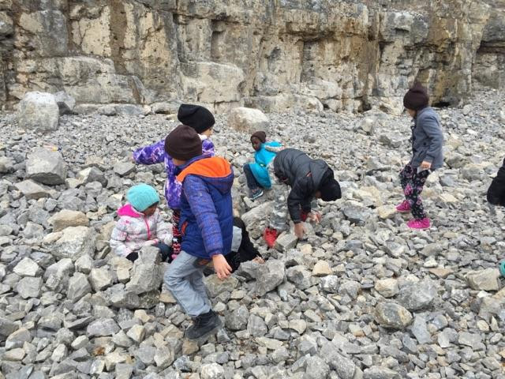
Field Experiences: Bringing Learning to Life
Embedded Enrichment Programming
Notes:
Transition to Anne –
Anne will explain the structure of daily embedded enrichment programming at Dr. Weeks

Slide 22
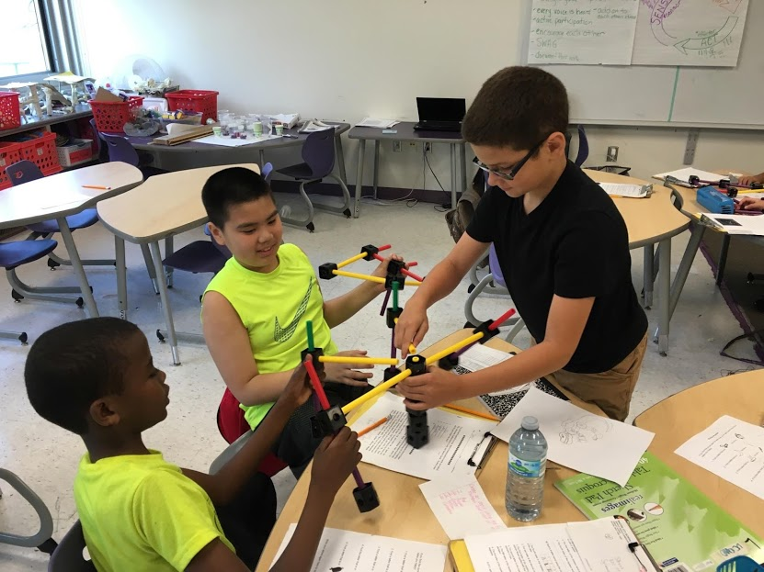
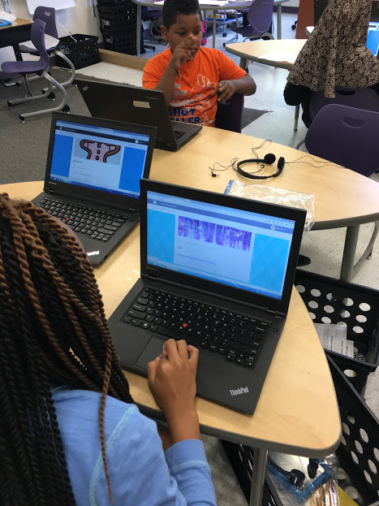
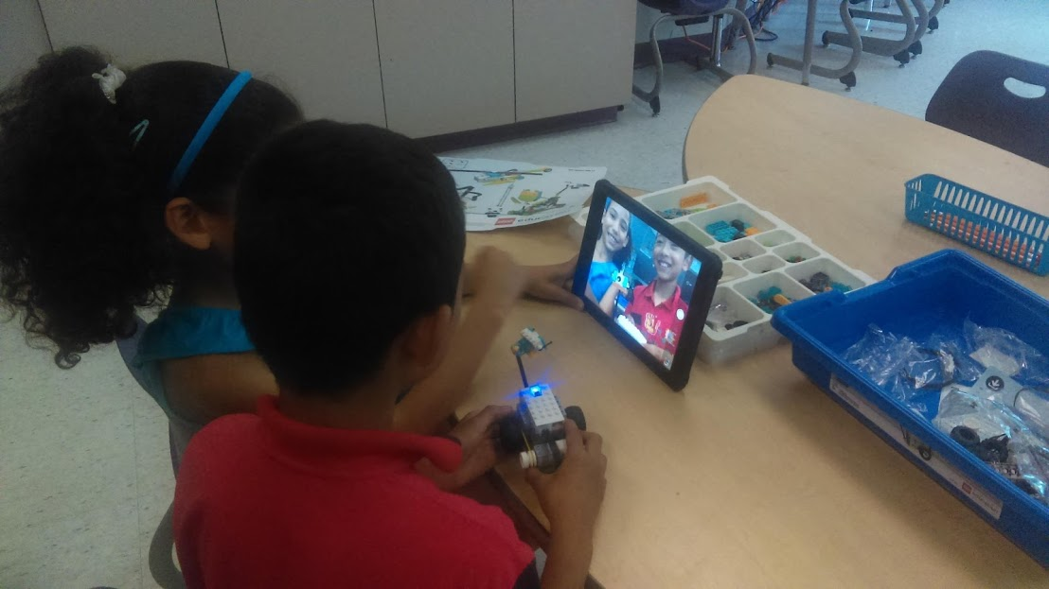
Applying what we have learned…
#SummerAcademy
Notes:
Matt will talk about how we used summer to apply what we have learned and practice new strategies

Slide 23
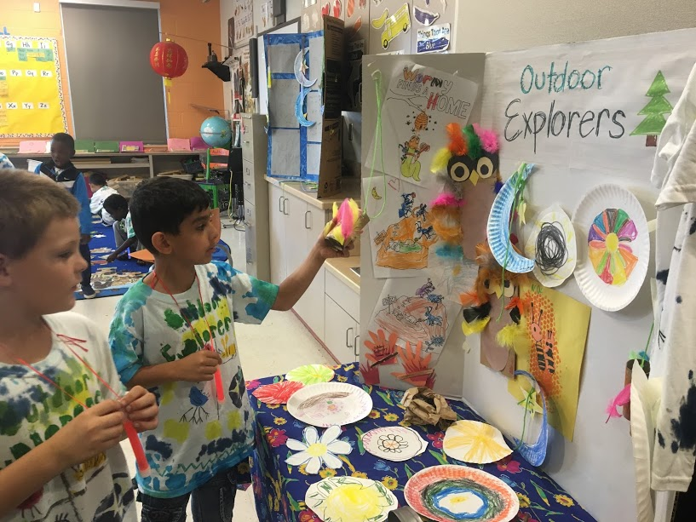
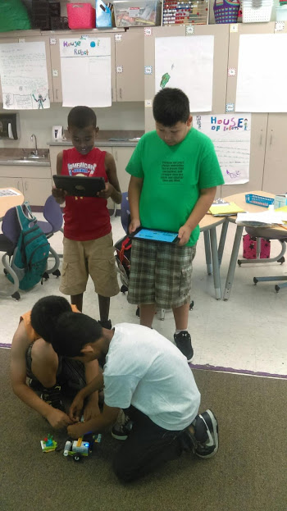
Outdoor Explorers
Healthy Living
Me, My Family, My Community
Around the World
Designing the Future
CSI: Classroom Science Investigators
The World Around Us
Around the World
Authors and Illustrators
I, Robot
Building Young Men
#SummerAcademy
Notes:
Matt will share the process that we used to develop themes, curriculum, and apply effective strategies

Slide 24

creeve-larham@scsd.us
@reevelarham on Twitter
Turnaroundschool.blogspot.com
www.syracusecityschools.com/drweeks
Contact Information

Slide 25
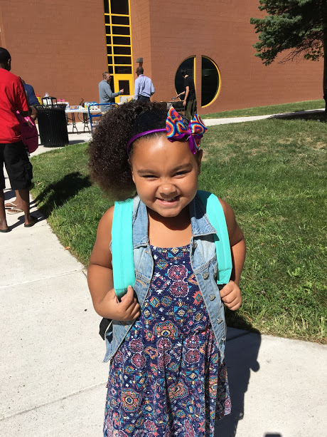
Questions?

Slide 26
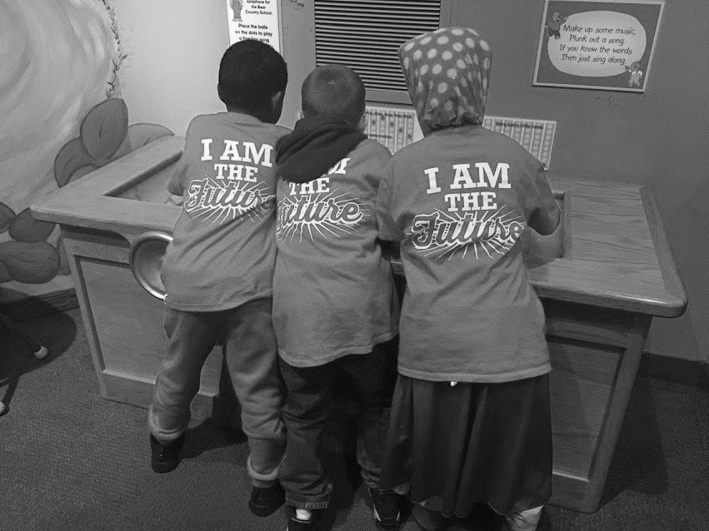
Notes:
Carin will introduce the presentation and the team
Share brief leadership story - how I came to Dr. Weeks

